Slide 1
Group 10
40 years of Apple, Inc.’s stock market trends in reference to the Gains & Losses

Slide 2
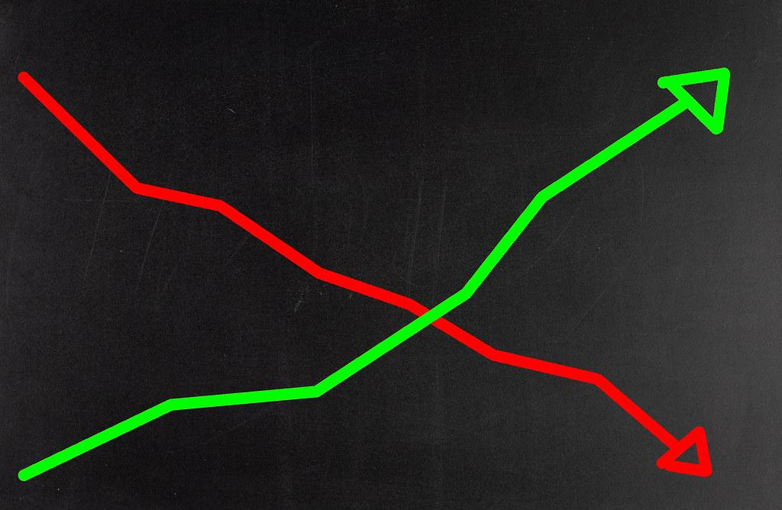
Content
Why this Topic?
Data Source
Database
Machine Learning
Dashboard
R-Analysis
Conclusion

Slide 3
Description of the communication protocols
X: Gabriel
Technology & R-Analysis
Circle: Remi
Database Integration & R-Analysis
Square: Ope
GitHub Repository & Dashboard
Triangle: Iry
Machine Learning & Powerpoint

Slide 4
Selected Topic
As it relates to human behavior, how do seasons, fiscal quarters, months, and even years compare in gains and losses, for Apple, Inc (APPL) stock?

Slide 5
Why this Topic?
We wish to predict the greatest opportunity for gains and avoid the greatest pitfalls for losses as one considers investing in Apple’s stock

Slide 6
Data Source
The dataset utilized is from Kaggle.com, titled the “NYSE”.
Link: https://www.kaggle.com/varpit94/apple-stock-data-updated-till-22jun2021
This dataset begins on Apple’s IPO, 12/12/1980, and ends on 12/5/2020

Slide 7
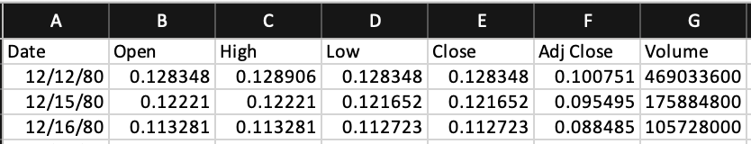
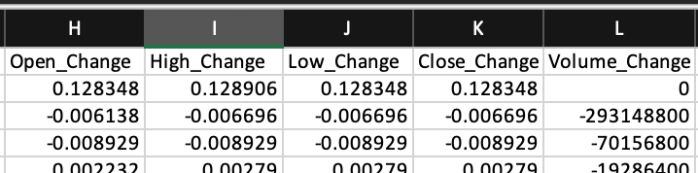
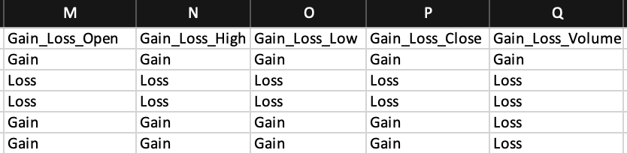
Database Integration: Data Pre-Processing
The Data Pre-Processing was based on figuring what story we were trying to tell.
Base dataset had the following features:
Date, Open, High, Low, Close, Adj Close, and Volume
The following features were later added via formulas and through a SQL join:
Season, Quarter, a 24hr change column for each price variable, and a Gain_Loss column based on its relative 24hr change column

Slide 8
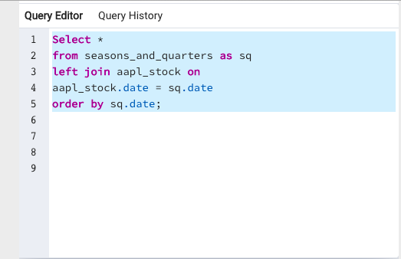
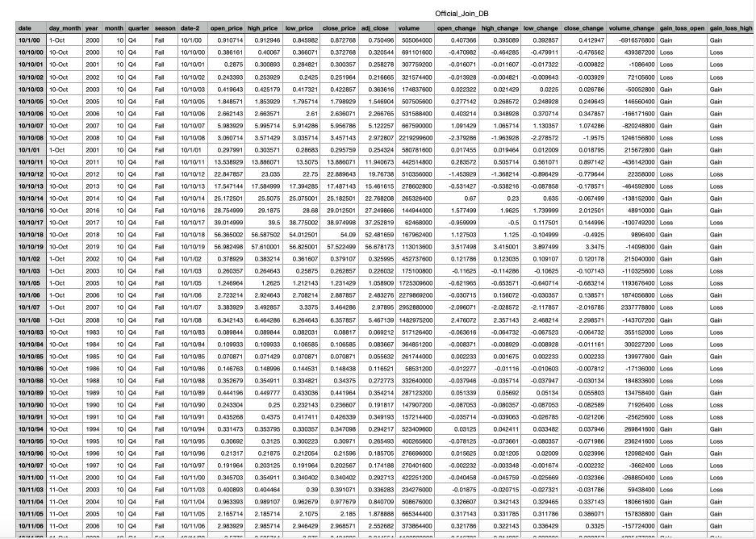
Database Integration: SQL
The database was joined by using the query below using the Kaggle dataset and season and quarter dataset.

Slide 9
Machine Learning Introduction
Preliminary
data pre-processing
feature engineering
feature selection
How the data is split into training and testing sets
Model choice, its’ limitations, and its’ benefits

Slide 10
Preliminary Feature Engineering & Feature Selection
Pre-Processing & Preliminary Feature Engineering
Features: Date, Season, Quarters, Price Variables, Volume, “<Price_Variable> _24hr_ Change”
Target: “Gain_Loss_<Price_Variable>” column (Open, Close, High, Low)
The “<Price_Variable>_24hr_Change” column
(current price - previous day’s price)
Calculated in chronological order by “Date”
The Gain_Loss column is based on the “<Price_Variable>_24hr_Change” column
“< 0 = ‘Loss’”
“>= 0 = ‘Gain’”
Preliminary Feature Selection
Based on Machine Learning studies, the target is based on two options only.
Examples:
0 or a 1
Yes or No
Approve or Deny
Gain or Loss
The Gain/Loss chosen as a target because gaining or losing on investments is what is important to the users of this model

Slide 11
Methodologies
Two models were tested (LR & RFM) but each of the two had a total of three different architectures applied
In both the Logistic Regression and the Random Forest Model:
Random state = 1, stratify = y, and the sample consisted of 7669 rows: 17 columns of our base architecture model, or 7669 rows: 18 columns for our model with our stock volume considerations, and lastly 7669 rows: 21 columns in model that has all change columns considered at once
However, in the Random Forest Model, although set up similarly to the Logistic Regression:
It did receive a higher accuracy by 3-5% upon changing the Random State from 78 to 1 in the models that considered price variables as targets
Alternatively, it received the best accuracy when the Random State was left at 78 for the models that considered the volume variable as the target instead of the price variables , as well as trained with 80% of the data

Slide 12
Three Architectures Tested
Structure 1: Base Dataset Features + Volume 24hr Change Feature + (1 of 4) Price Variable 24hr Change Columns as the Target
Total of 4 sub-models based on the Gain_Loss of the price variable’s 24hr Change:
Open
Close
High
Low
Structure 2: Base Dataset Features + Volume 24hr Change Column as the Target
A model based on the volume’s 24hr change column with its respective Gain_Loss column as the target
Structure 3: Base Dataset Features + All Price Variable 24hr Change Features + Volume 24hr Change Column as the Target
A model based on all price variable 24hr changes at once rather than separately, and the volume’s respective Gain_Loss column as the target

Slide 13
Accuracy
Logistic Regression
Random Forest Model
Price Variables:
Low = 56%
Close = 54%
High = 55%
Open = 54%
Volume Variables:
With Volume 24hr Change Column
58%
With All Price Variable 24hr Change Columns as features with Volume Change as target
58%
Price Variables:
Low = 61%
Close = 63%
High = 60%
Open = 58%
Volume Variables:
With Volume 24hr Change Column
66%
With All Price Variable 24hr Change Columns as features with Volume Change as target
72%

Slide 14
Model Choice, Model Limitations & Benefits
Both Logistic Regression and Random Forest Model were great choices because everything is measured through time and time runs linear, ultimately:
We officially settled on the Random Forest Model because, not only is it a regression that works well in time, but it is beneficial in weighing the importance of each feature, and ultimately this weight answers our questions.
Model limitations are that for time, the date format was not enough for the model to read. We had to convert dates to the “toordinal” time format which turns out to be the machine’s most preferred language

Slide 15
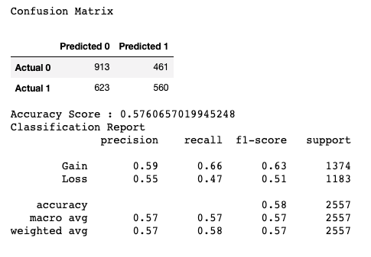
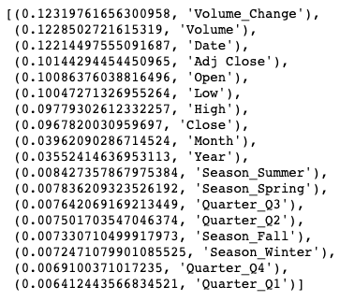
RFM Confusion Matrix & Feature Importance: Open
Open
Open

Slide 16
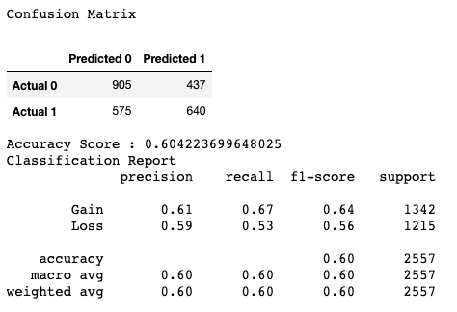
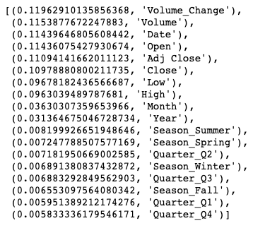
RFM Confusion Matrix & Feature Importance: Close
Close
Close

Slide 17
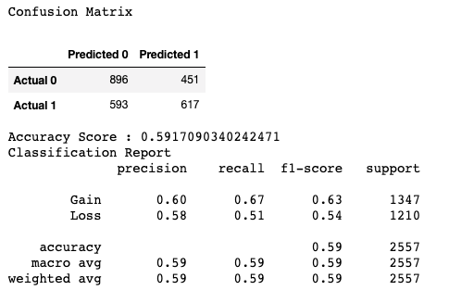
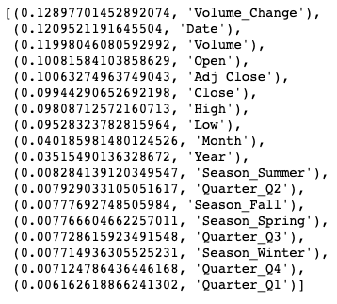
RFM Confusion Matrix & Feature Importance: High
High
High

Slide 18
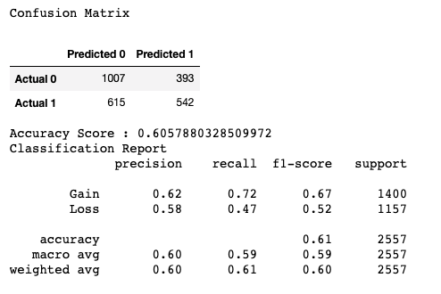
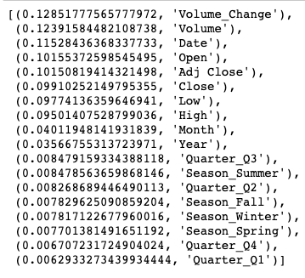
RFM Confusion Matrix & Feature Importance: Low
Low
Low

Slide 19
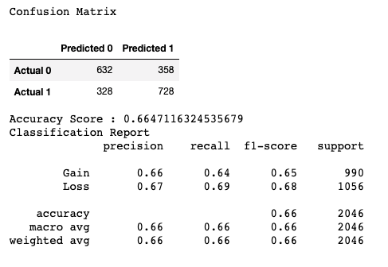
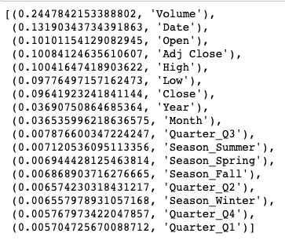
RFM Confusion Matrix & Feature Importance: Volume
Volume
Volume

Slide 20

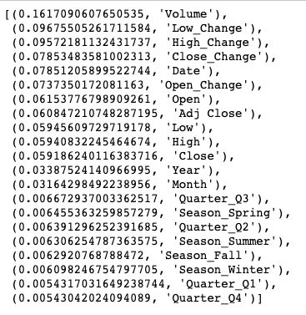
RFM Confusion Matrix & Feature Importance: Volume as Target with All 24hr Price Change Variables as Features
Volume with All 24hr Price Variable Changes
Volume with All 24hr Price Variable Changes

Slide 21
Concluding Observations Made in Machine Learning:
Volume was significant to accuracy of Gain/Loss predictions
When combined with volume, the “Open” price variable weighed the most of all price variables
Opportunity for gains were most significant:
Spring ranked highest in importance, with summer tightly following
Spring: Mar 1 – May 31
Summer: June 1 – Aug 31
The 3rd Fiscal Quarter ranked as the highest quarter
July 1 – Sept 30
Moments of the greatest losses occurred:
In the winter season
Dec 1 – Feb 28
Tie between the 1st and 4th Fiscal Quarter
1st Q: Jan 1 – Mar 31
4th Q: Oct 1 – Dec 31

Slide 22
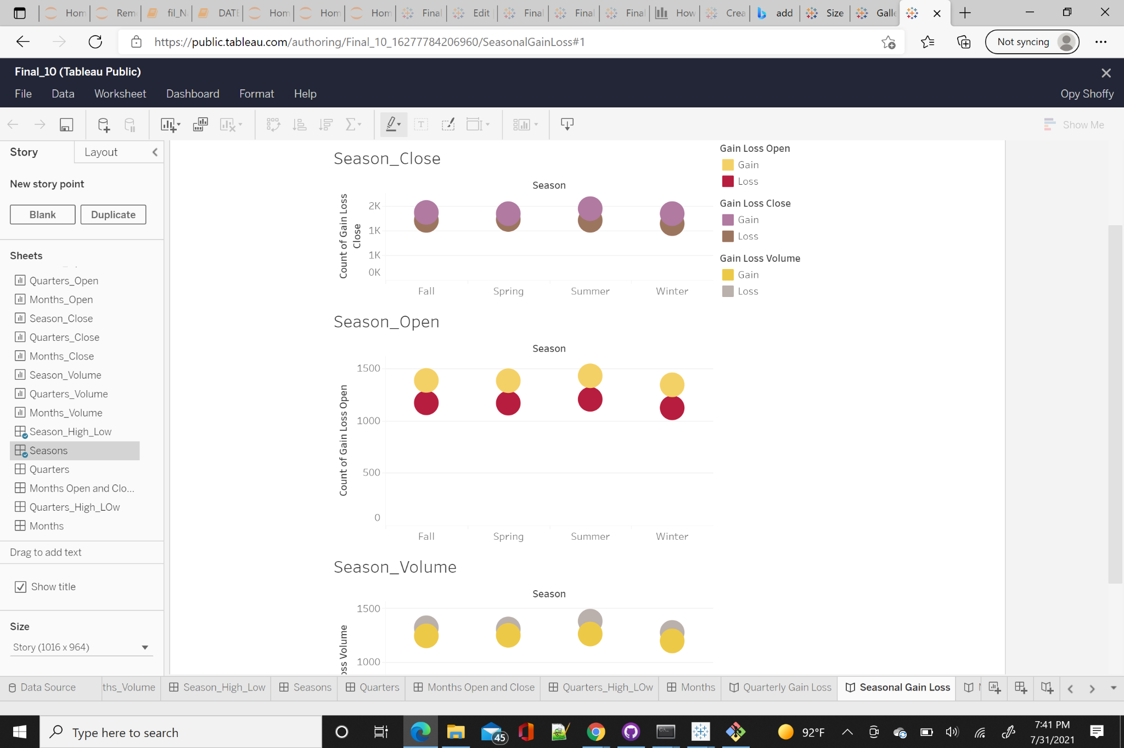
Dashboard
The dashboard contains worksheets, dashboard and stories that explains the connection between Seasonal, Quarterly and Monthly Gain/Loss. Attached is the link to the dashboard:
https://public.tableau.com/app/profile/opy.shoffy/viz/Final_Project_10_16277782240420/QuarterlyGainLoss

Slide 23
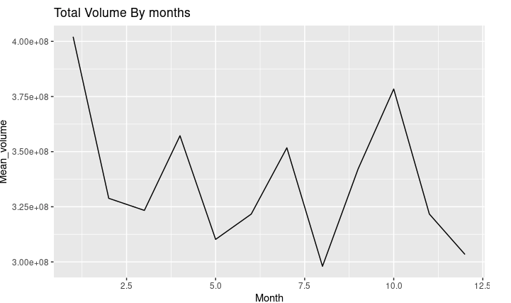
R-Analysis
Total Volume by months

Slide 24
Conclusion of Analysis:
In conclusion, our analysis of Machine Learning, R-analysis, and Dashboard Demonstrations support the following:
Volume was significant to accuracy of Gain/Loss predictions
When combined with volume, price variables had a higher accuracy than without volume consideration, and the “Open” price variable weighed the most in importance of all price variables
Opportunity for gains were most significant:
In the summer
During the 3rd Fiscal Quarter and 2nd Fiscal Quarter
Moments of the greatest losses occurred:
In the winter season
Tie between the 1st and 4th Fiscal Quarter

